Slide 1
Integrating security in DevOps do and don’ts
Victoria Almazova

Slide 2
Integrating security in DevOps do and don’ts Year later
Victoria Almazova

Slide 3
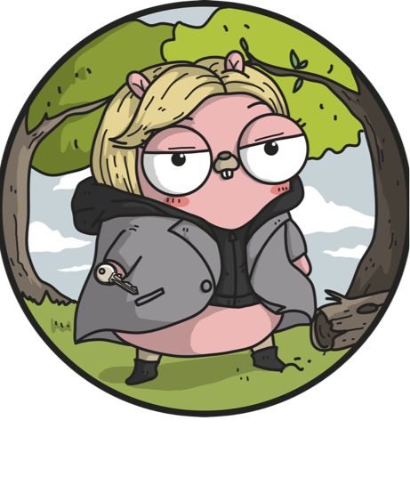
Victoria Almazova
Security girl in Microsoft
Always curious about what happens under the hood
@texnokot
https://github.com/texnokot
Notes:
For software that is distributed externally, this should involve signing the code with a code-signing certificate from a third-party CA. For internal code, a hash should be enough to ensure code integrity.

Slide 4


Slide 5


Slide 6

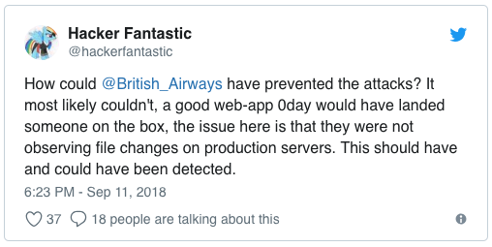
22 lines of code to steal British Airways’ customer data
Compromised 380 000 customers
77 000 addresses, emails, payment details
108 000 credit/debit cards CVV
Notes:
British Airways acknowledged that its website had been hacked – leading to 380,000 customers‘ data being compromised.
Between Aug. 21 and Sept. 5,
between April 21 and July 28. 2nd breach discovered

Slide 7
22 lines of code of JavaSript in modernizr-2.6.2.min.js
https://www.riskiq.com/blog/labs/magecart-british-airways-breach/

Slide 8
Hacked by Magecart
https://www.riskiq.com/blog/labs/magecart-british-airways-breach/

Slide 9
Lessons learned
Notes:
Prevent attack? No
Detect. Yes.

Slide 10
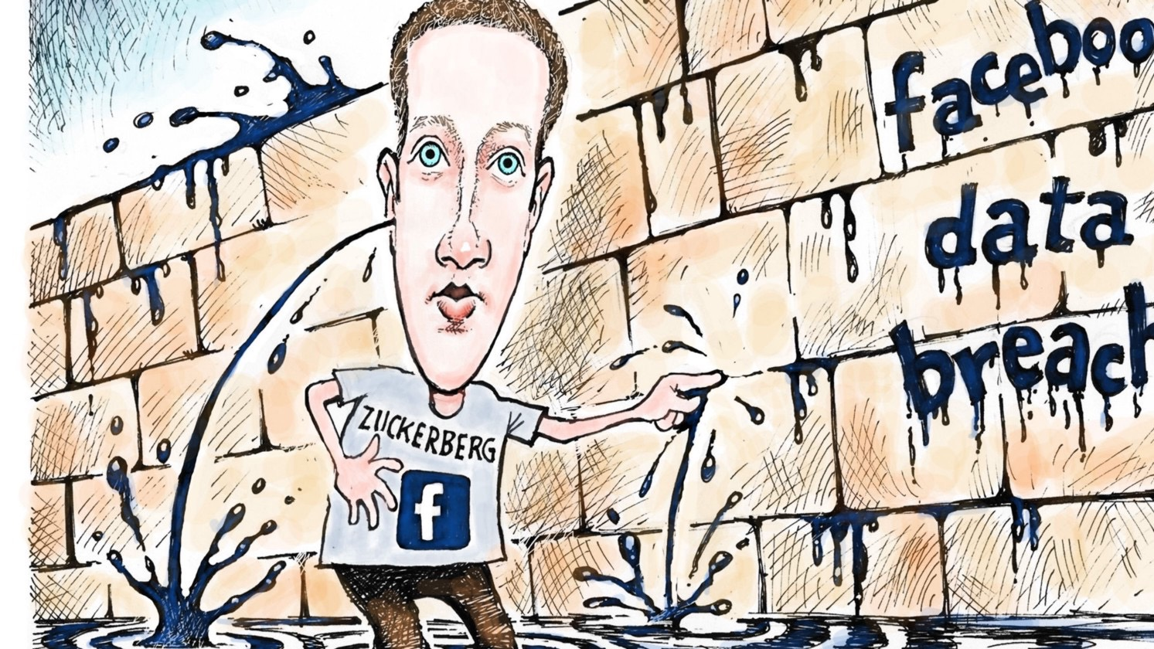
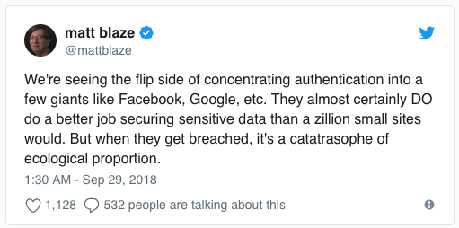
50 Million Facebook users were hacked
Notes:
Three software flaws in Facebook’s systems allowed hackers to break into user accounts,
Once in, the attackers could have gained access to apps like Spotify, Instagram and hundreds of others that give users a way to log into their systems through Facebook.
The software bugs were particularly awkward for a company that takes pride in its engineering: The first two were introduced by an online tool meant to improve the privacy of users. The third was introduced in July 2017 by a tool meant to easily upload birthday videos.
Facebook said the attackers had exploited two bugs in the site’s “View As” feature, which allows users to check on what information other people can see about them. The feature was built to give users move control over their privacy.
The company said those flaws were compounded by a bug in Facebook’s video-uploading program for birthday celebrations, a software feature that was introduced in July 2017. The flaw allowed the attackers to steal so-called access tokens — digital keys that allow access to an account.
The company forced more than 90 million users to log out early Friday, a common safety measure taken when accounts have been compromised.

Slide 11
3 vulnerabilities in the “View As” functionality
A video uploader to show up in “View As”
Generated an access token for mobile app
New access token not for a user, but for “view as” person
Notes:
The hackers took advantage of three distinct vulnerabilities chained together in order to steal the tokens, Rosen said.

Slide 12
Lessons learned
Notes:
Identity, access can be hard
Behavioral analysis is your friend, suspicious activities and etc

Slide 13
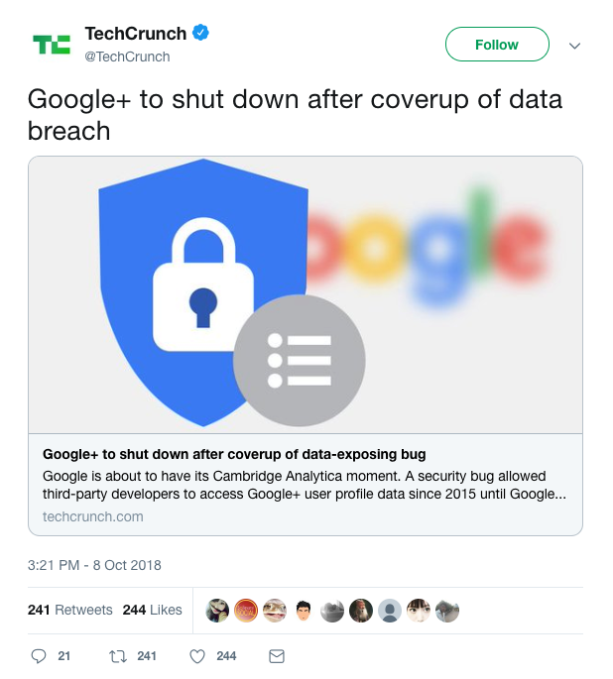
500,000 Google+ accounts may have been compromised
Notes:
The vulnerability itself seems to have been relatively small in scope. The heart of the problem was a specific developer API that could be used to see non-public information. But crucially, there’s no evidence that it actually was used to see private data, and given the thin user base, it’s not clear how much non-public data there really was to see. The API was theoretically accessible to anyone who asked, but only 432 people actually applied for access (again, it’s Google+), so it’s plausible that none of them ever thought of using it this way.
The bigger problem for Google isn’t the crime, but the cover-up.

Slide 14
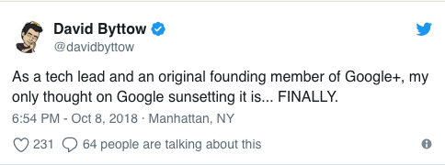
Notes:
90% of G+ sessions were less than 5 seconds

Slide 15
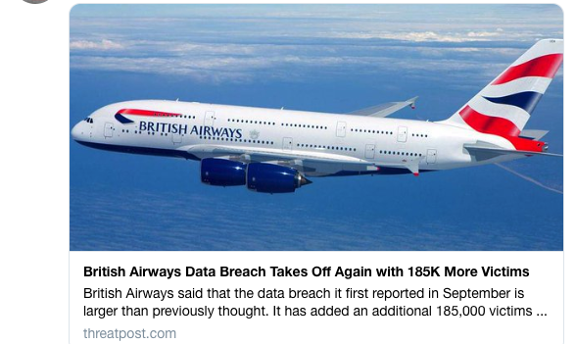
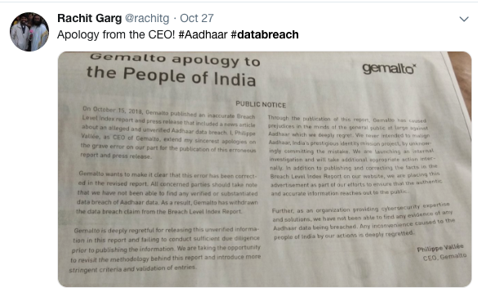
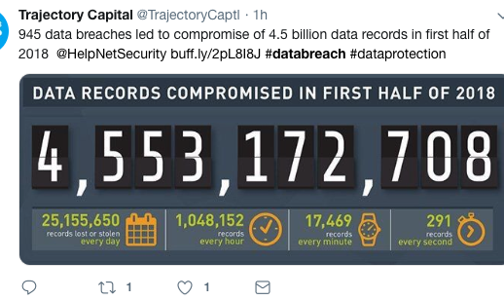
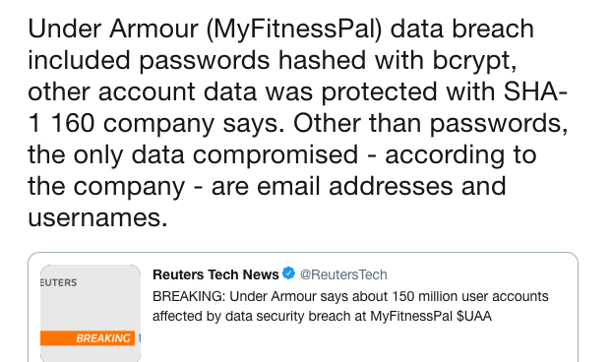
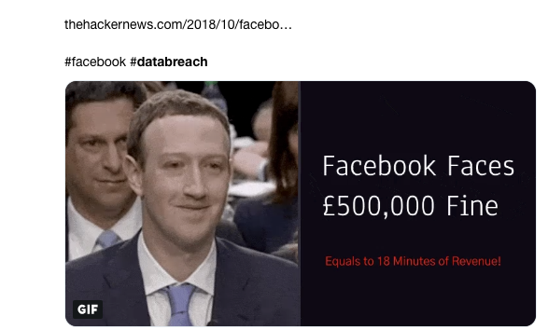
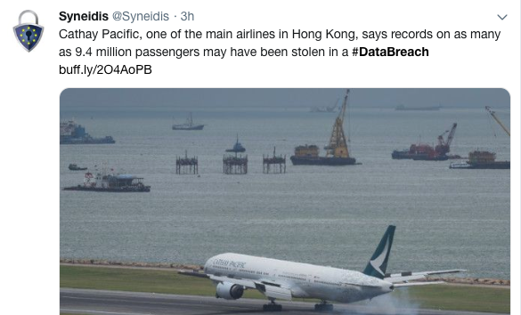
#databreach

Slide 16
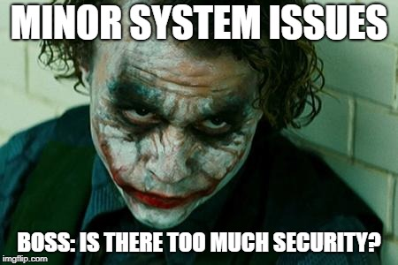

Slide 17
Embrace and enhance education

Slide 18
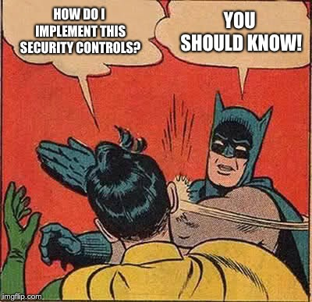
Notes:
This is not an answer!
Put investment in your developers. Send them to the proper conferences, like Defcon. So they get real feeling of atmosphere.
Wall of shame. And etc

Slide 19
Build Security champions

Slide 20

https://en.wikipedia.org/wiki/Generation_Snowflake

Slide 21
You control code You control security

Slide 22

Bringing security into the Pipeline

Slide 23
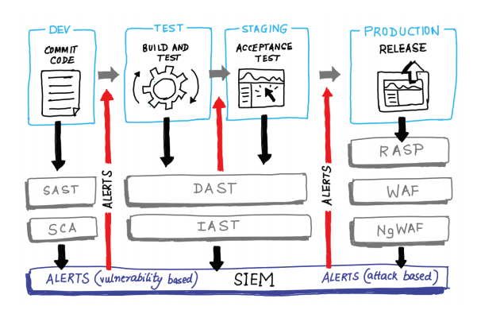

Slide 24



Develop and commit the code
Before you commit
Get rid of secrets from the code. Finally
Static analysis checking in the developer’s IDE
Threat Modeling
Peer code review
Notes:
For software that is distributed externally, this should involve signing the code with a code-signing certificate from a third-party CA. For internal code, a hash should be enough to ensure code integrity.
(Google, Amazon, Facebook, and Etsy)

Slide 25
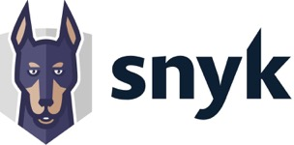


Develop and commit the code
Commit
Software component analysis in 3rd party components
Incremental static analysis scanning
Automated unit testing of security functions
Digitally signing binary artifacts
Notes:
For software that is distributed externally, this should involve signing the code with a code-signing certificate from a third-party CA. For internal code, a hash should be enough to ensure code integrity.
Erlend Oftedal from RetireJS
Unit test focus on negative tests

Slide 26
Staging
Acceptance stage
Secure and automate configuration management and provisioning
Smoke tests to catch mistakes in configuration or deployment
Dynamic application security testing
Automated security attacks
Fuzzing of APIs
Manual pen testing
Red teaming
Notes:
Ansible, Chef, Puppet
DAST tools run on operating code to detect issues with interfaces, requests, responses, scripting (i.e. JavaScript), data injection, sessions, authentication, and more.

Slide 27
Production
Going and staying alive
Cloud resources governance and provisioning
Runtime checks and monkeys
IAM hygiene
Security scanning
Alerting and monitoring
Bug Bounty program
Blameless postmortems
Notes:
This is why Netflix created the Simian Army, a set of automated runtime checks and tests, including the famous Chaos Monkey.
AWS Inspector and Security Center

Slide 28
Make security as a culture

Slide 29
Thank you!
Victoria Almazova

